Slide 1
Introduction to Julia
By Nashra Ghaffar (CT-20032)

Slide 2

What is Julia?
“ Julia is a high-level, high-performance dynamic programming language designed for numerical and scientific computing, data science, and machine learning. “

Slide 3



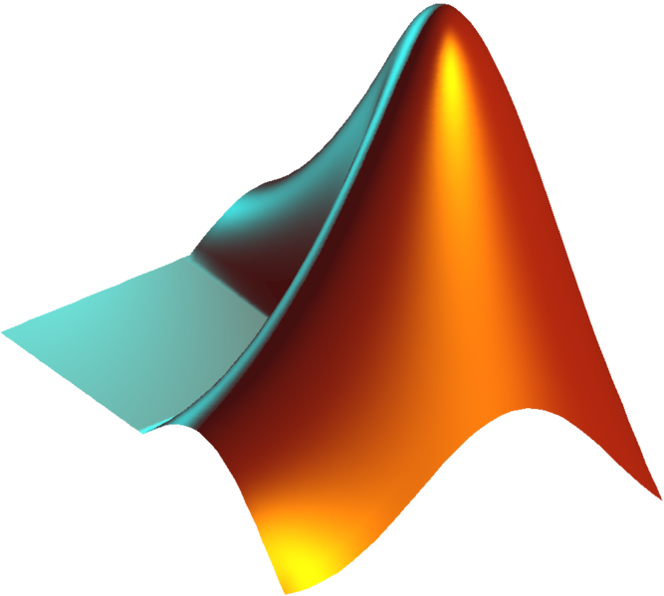
What is Julia?

Slide 4
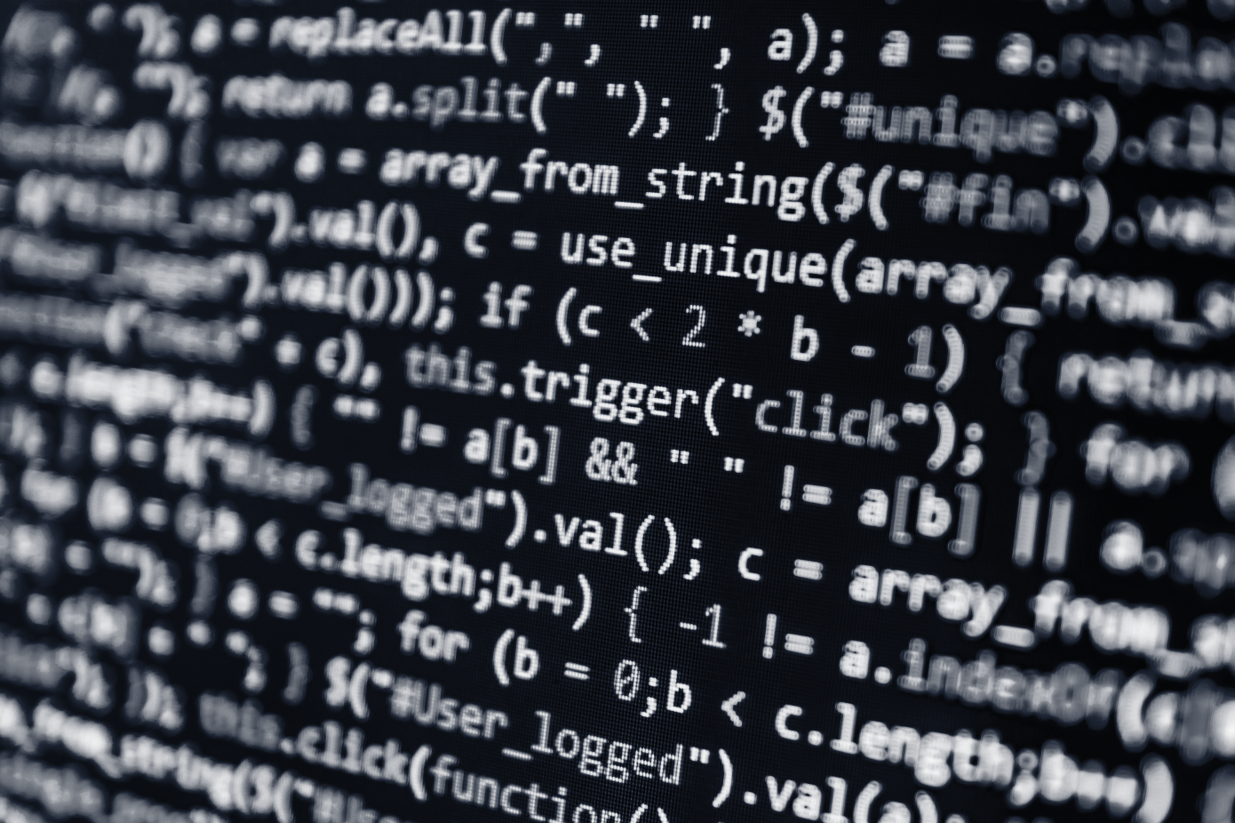
History of Julia
Julia was created in 2009 and released to the public in 2012 by a group of computer scientists and mathematicians at MIT, led by Jeff Bezanson, Stefan Karpinski, Viral Shah, and Alan Edelman.
The team was looking for a programming language that could provide the ease of use of languages like Python and R, but with the performance of languages like C and Fortran.

Slide 5
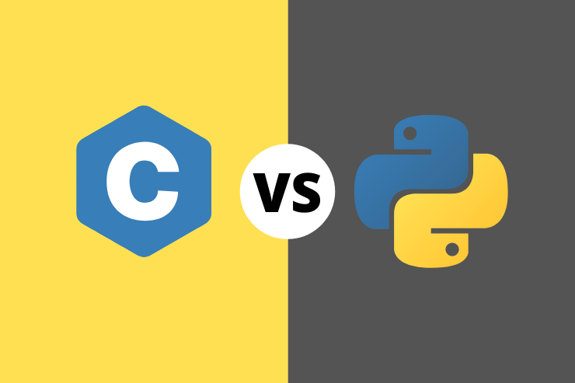
C VS Python
In general, C is considered faster than Python because C is a compiled language and Python is an interpreted language. When C code is compiled, it is translated into machine code which can be executed directly by the computer's processor. This makes C code faster and more efficient than Python code, which is interpreted at runtime.

Slide 6

Is Julia Open Source?
Yes, Julia is an open-source programming language, which means that its source code is freely available to anyone who wants to use, & modify.
Anyone can contribute to the development of the language by submitting bug reports, suggesting improvements, or even contributing code.
Freely available to anyone, regardless of their financial means or location.

Slide 7

Syntax of Julia
Julia is designed with a syntax that is easy to learn and read, with a focus on mathematical notation, making it an attractive language for scientists and researchers.

Slide 8
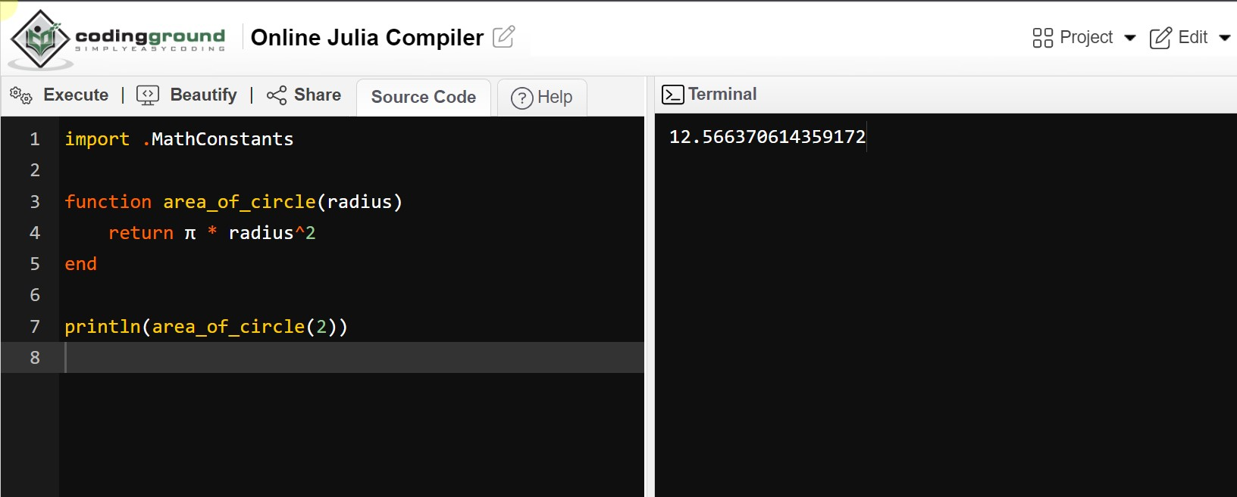
Syntax of Julia

Slide 9

Just-in-Time (JIT) Compilation
Julia uses a JIT compiler to generate optimized machine code on the fly, resulting in performance that is often comparable to compiled languages like C and Fortran.

Slide 10
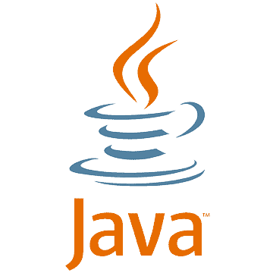



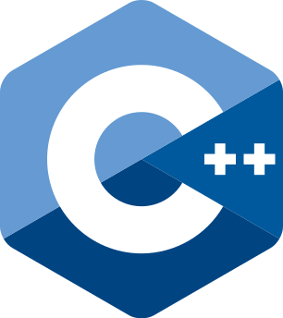








JIT
AOT

Slide 11

Distributed & Parallel Computing
Julia is a programming language that has built-in support for parallel and distributed computing, which means that it can easily distribute computations across multiple processors or machines to solve complex problems.

Slide 12
Advantages of Distributed & Parallel Computing
Speed
Scalability
Flexibility
Cost
Effective
Easy to use

Slide 13

Packages in Julia
Julia has a rich ecosystem of packages and tools for various domains, including machine learning, optimization, statistics, and more.
Julia's ecosystem of packages and tools is one of its key strengths, as it provides users with a wide range of resources that can be used to solve a variety of problems and tackle complex challenges in scientific and technical computing.

Slide 14
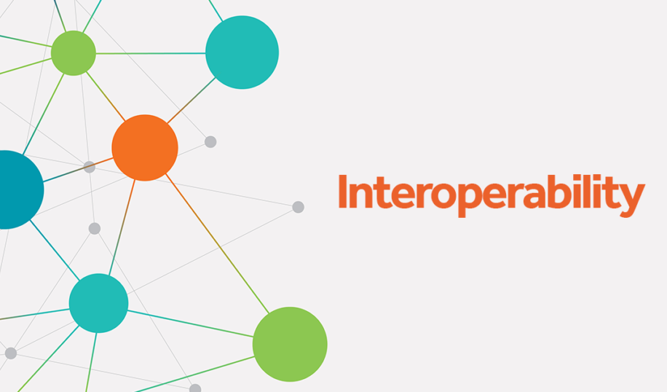
Interoperability
Julia has built-in support for calling C and Fortran code, as well as a growing number of packages for interfacing with other languages like Python and R.

Slide 15

Future of Julia
Julia is already being used in industry for tasks like data analysis, optimization, and machine learning.
Julia is also gaining popularity in academia, where it is being used for scientific computing, numerical simulations, and research in fields like physics and economics.
Some companies and organizations that use Julia include NASA, BlackRock, and the Federal Reserve Bank of New York.

Slide 16
THANK YOU !!

